Slide 1
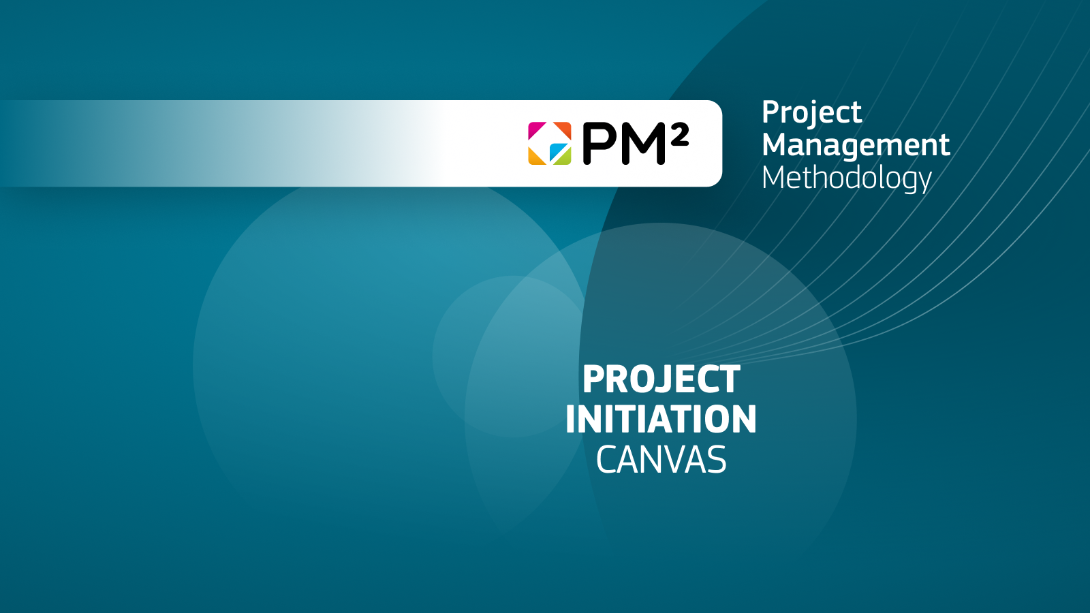
Project Name: ________________
Date: ______________
Prepared by: __________________

Slide 2
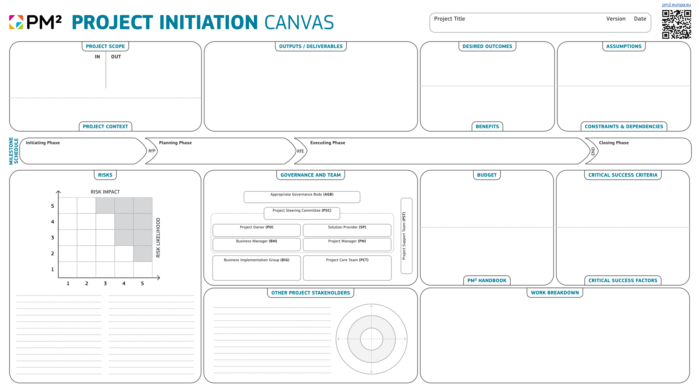

Slide 3
The Project Initiation PM² Canvas can be used in various ways to enhance project management and communication
Project kick-off workshops: The PM² Canvas can serve as a tool during project kick-off meetings. It encourages teams to collaborate in defining the project scope, identifying risks, and aligning expectations on deliverables and desired outcomes. This collaborative approach ensures everyone is on the same page from the outset. For instance, each section can be filled out during brainstorming sessions, facilitating discussions on assumptions, constraints, and critical success factors.
Visual overview for stakeholders: The PM² Canvas provides a clear, visual overview of the project, making it ideal for communicating with stakeholders. It can be used during presentations to provide an at-a-glance summary of key project elements, such as scope, deliverables, and risks, helping stakeholders understand the project's goals and progress without using lengthy documentation. This is particularly useful for senior management or partners who need high-level insights.
Risk and stakeholder management workshops: The PM² Canvas can be used in focused risk and stakeholder management workshops, where the team gathers to identify and assess risks based on the likelihood and impact matrix, and stakeholders analysis. This collaborative exercise can help surface potential issues early, allowing the project team to develop mitigation strategies. Teams can revisit the PM² Canvas regularly to update risks and assess the effectiveness of their mitigation efforts throughout the project lifecycle.
Cooperation between Teams: Using a standardised format of the PM² Canvas enhances project information clarity for cross-project collaboration. This approach enables teams to share insights more effectively, facilitating cooperation and knowledge exchange among teams facing similar challenges.
Customised Agile iteration planning: While the PM² Canvas is mostly used in traditional project management, it can also be adapted for Agile teams, used to outline the scope of an iteration, and identify risks specific to that sprint, allowing Agile teams to benefit from the structured clarity of the PM² Canvas.
Tracking project milestones: The Milestone Schedule section of the PM² Canvas can be used to track the progress of the project phases, mark completed milestones and adjust the schedule when needed, ensuring the expected milestones or delays are visible.
Information radiator: The PM² Canvas can act as an information radiator, serving as a large, highly visible poster displayed in open office spaces or shared digitally in team dashboards. Teams can refer to it in every meeting to stay aligned on key objectives and milestones, ensuring discussions focus on critical topics affecting project delivery.
Training and development for project teams: The PM² Canvas can be used an effective educational tool for teams new to project management frameworks. In training sessions, using a sample canvas allows new project managers and teams to practice project initiation and planning, helping them understand how the various elements of a project are interrelated.
Project-End review and lessons learned: The PM² Canvas can also serve as reflection tool for the closing phase. Upon project closure, it can be revisited to assess how closely the actual project outcomes aligned with the initial scope, deliverables, risks, and success criteria.

Slide 4
Project Scope (IN/OUT): The project scope defines the boundaries of what the project will include (IN) and what will be excluded (OUT). Scope captures what the project will deliver and what it won’t. Guidelines: Clearly list all activities the project will cover in the "IN" section, and explicitly identify any areas, tasks, or deliverables that are excluded in the "OUT" section. For instance, if developing a new website, IN might include building the main site, while OUT could exclude ongoing maintenance post-launch.
Outputs / Deliverables: Deliverables are the tangible or intangible products or services that will be produced as part of the project. Guidelines: Document the specific outputs that will be produced during the project, such as studies, publications, software applications, training manuals, etc.
Desired Outcomes: Outcomes are the broader results the project aims to achieve, often tied to long-term goals or changes. Guidelines: Define the end-state aimed for, the changes or improvements the project will bring about, beyond just the deliverables. For example, a desired outcome could be a decrease in project overruns after implementing a project management system.
Assumptions: Assumptions are things believed to be true at the time of planning, but which might not be guaranteed. Guidelines: List assumptions that could impact the project’s success, and then try to confirm the validity of the assumption. If this is not possible, raise a risk. For example, assuming that a specific resource will be available during a specific time of the project.
Benefits : Benefits are the measurable improvements or advantages that will result from the project’s outcomes. Guidelines: State the clear and measurable benefits that the project will bring. These could be financial, operational, or strategic benefits. For example, reducing the cost of operations by 15% or 100K by automating key processes.
Constraints: Constraints are the limitations or restrictions within which the project must operate, such as availability of budget, schedule, procurement procedures, access to specific resources, etc. Guidelines: Identify the project's key constraints, such as specific deadlines, resource limitations, or budget caps. For example, a constraint might be completing the project before a new policy is in effect, and with internal resources and capabilities.
Milestone Schedule: This outlines the key milestones of each Phase, including the expected dates of the Phase Gates. Guidelines: Define key stages and milestones, marking key decision points or deliverable dates. For example, a milestone could be the completion of deliverable by a specific date, followed by its acceptance.
Critical Success Criteria: These are specific conditions that must be met for the project to be considered successful. Guidelines: Identify measurable indicators that define project success, such as meeting deadlines or delivering within budget. For example, in a conference project, success could be defined as having at least 80% of the venue full of participants from at least 20 different countries.
Critical Success Factors: Critical success factors are the elements that are essential for the project to succeed. Guidelines: Identify the conditions that are necessary for the project's success, such as stakeholder engagement, sufficient resource allocation, or strong project governance. For example, strong project sponsorship from senior management might be critical.
Risks: Risks are uncertain events that could (negatively or positively) affect the project. Guidelines: Use the risk matrix to assess risks based on their likelihood and impact. Summarise Capture your top risks and mitigation strategies. For instance, a risk might be a delay in critical contractor deliverables, and mitigation/transfer could involve establishing relevant contractual penalties.
Stakeholders: Stakeholders are individuals or groups who have an interest in the project or/and its outcomes. Guidelines: List key stakeholders and map their influence and support levels. For instance, internal stakeholders may include senior management, while external stakeholders could include users or contractors.
Governance and Team: Governance defines who makes decisions and oversees the project. It identifies its roles and its structure. Guidelines: List the key members of the governance structure.
Budget: The budget is the financial estimate for the project, covering costs such as personnel, resources, and materials. Guidelines: Provide an estimate of the project costs, broken down into categories. Include any contingency funds for unforeseen expenses.
PM² Handbook: Refers to the management approach to be used such as PM² or/and other more (domain) specific approaches. Guidelines: Reference the PM² Handbook for templates, guidelines, and processes.
Work Breakdown: A Work Breakdown Structure (WBS) divides the project into manageable tasks or work packages. Guidelines: Break the project down into smaller chunks of work and connect them to the project deliverables.

